Slide 1
MINIPROJECT
VACCINE ON TIME
Submitted To:
Soumya John
Submitted By:
Chinmai Unni
Roll No:13
Third Year B.C.A

Slide 2
INTRODUCTION
Digital technology has changed many sectors, including healthcare
Managing vaccination schedules is one area that can greatly benefit.
Our project is called "VACCINE ON TIME - Vaccination Booking and Scheduler."
It helps solve problems with traditional vaccination booking systems.
The platform is easy to use for everyone, including parents and adults.
It allows users to book vaccination appointments quickly.

Slide 3
It also keeps track of all vaccination records in one place.
Healthcare providers can manage appointments more efficiently.
This reduces their workload and improves communication with patients
It encourages more people to get vaccinated on time.
The project supports public health goals by making vaccinations easier
We aim to increase the success of vaccination campaigns.
Ultimately, our goal is to create a healthier society for all ages.

Slide 4
OBJECTIVES
Develop a user-friendly platform to simplify booking and scheduling vaccination appointments for all ages.
Maintain an organized and accessible record of vaccination history for easy access to essential health information.
Reduce administrative burdens for healthcare providers by improving appointment management and communication with patients.

Slide 5
TOOLS USED
FRONT END
HTML5
CSS
JavaScript
PHP
BACK END
MySQL

Slide 6
MODULES
MODULE 1: ADMIN
This module is for administrator where it ensures the platform runs smoothly by managing system, users and all the settings of the website.
Functionalities of admin includes:
Login
Add location details
Registration rules
Verification of hospital and user

Slide 7
MODULE 2: HOSPITAL CENTER
This module is for hospital center which can add available vaccines to the website.
Functionalities of hospital center includes:
Login
Settings
Add vaccines
View user order
Update status
Logout

Slide 8
MODULE 3: USER
This module is for users who can book vaccines and access vaccination records.
The functionalities of user includes:
Login
Settings
Search vaccines
Book vaccines
Payment
View booking status
Acknowledgement
Review or feedback

Slide 9
TABLE DESIGN
Table Name: tbl_admin
Primary key: admin_id
Table Name: tbl_district
Primary key: district_id
Field Name | Data type and size | Description
admin_name | Varchar(50) | Name of admin
admin_email | Varchar(50) | Email of admin
admin_password | Varchar(50) | Password of admin
Field Name | Data type and size | Description
district_name | Varchar(50) | Name of district
Table Name: tbl_place
Primary Key: place_id
Foreign Key: district_id
Table Name: tbl_category
Primary key: category_id
Field Name | Data type and size | Description
place_name | Varchar(50) | Name of Place
Field Name | Data type and size | Description
category_name | Varchar(50) | Name of category

Slide 10
Table Name: tbl_user
Primary key: user_id
Foreign Key: place_id
Table Name: tbl_center
Primary key: center_id
Foreign Key: place_id
Field Name | Data type and size | Description
center_name | Varchar(50) | Name of center
center_email | Varchar(50) | Email of center
center_password | Varchar(50) | Password of center
center_address | Varchar(50) | Address of center
center_contact | Varchar(50) | Contact of center
center_photo | Varchar(50) | Photo of center
center_proof | Varchar(50) | Proof of center
Field Name | Data type and size | Description
user_name | Varchar(50) | Name of user
user_gender | Varchar(50) | Gender of user
user_email | Varchar(50) | Email of user
user_password | Varchar(50) | Password of user
user_address | Varchar(50) | Address of user
user_contact | Varchar(50) | Contact of user
user_photo | Varchar(50) | Photo of user
user_proof | Varchar(50) | Proof of user

Slide 11
Table Name: tbl_vaccine
Primary key: vaccine_id
Foreign Key: category_id
Table Name: tbl_hospitalvaccine
Primary key: hospitalvaccine_id
Foreign Key: vaccine_id,center_id
Field Name | Data type and size | Description
vaccine_name | Varchar(50) | Name of vaccine
Field Name | Data type and size | Description
hospitalvaccine_amount | Varchar(50) | Price of vaccine
Table Name: tbl_slot
Primary key: slot_id
Foreign Key: center_id
Table Name: tbl_booking
Primary key: booking_id
Foreign Key: user_id,slot_id
Field Name | Data type and size | Description
slot_from | Varchar(50) | Start of timeslot
slot_to | Varchar(50) | End of timeslot
slot_count | Varchar(50) | Slot number
Field Name | Data type and size | Description
booking_date | Varchar(50) | Date of booking
booking_slot | Varchar(50) | Slot of booking
booking_status | Varchar(50) | Status of booking

Slide 12
Table Name: tbl_review
Primary key: review_id
Foreign Key: user_id
Table Name: tbl_complaint
Primary key: complaint_id
Foreign Key: user_id,center_id
Field Name | Data type and size | Description
review_comment | Varchar(50) | Store review content
review_count | Varchar(50) | Store review count
review_date | Varchar(50) | Store date of review
Field Name | Data type and size | Description
complaint_title | Varchar(50) | Title of complaint
complaint_content | Varchar(50) | Content of complaint
complaint_reply | Varchar(50) | Reply to complaint
complaint_status | Varchar(50) | Status of complaint
complaint_date | Varchar(50) | Date of complaint

Slide 13
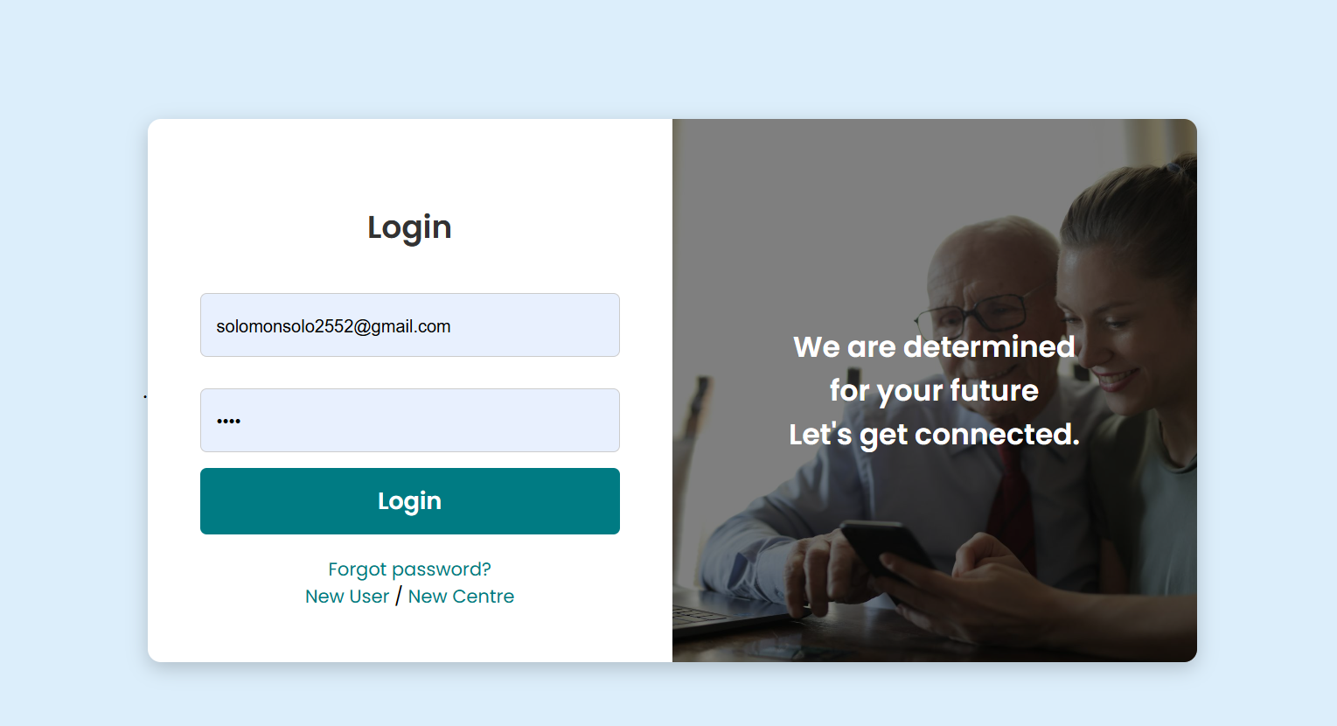
LOGIN PAGE

Slide 14
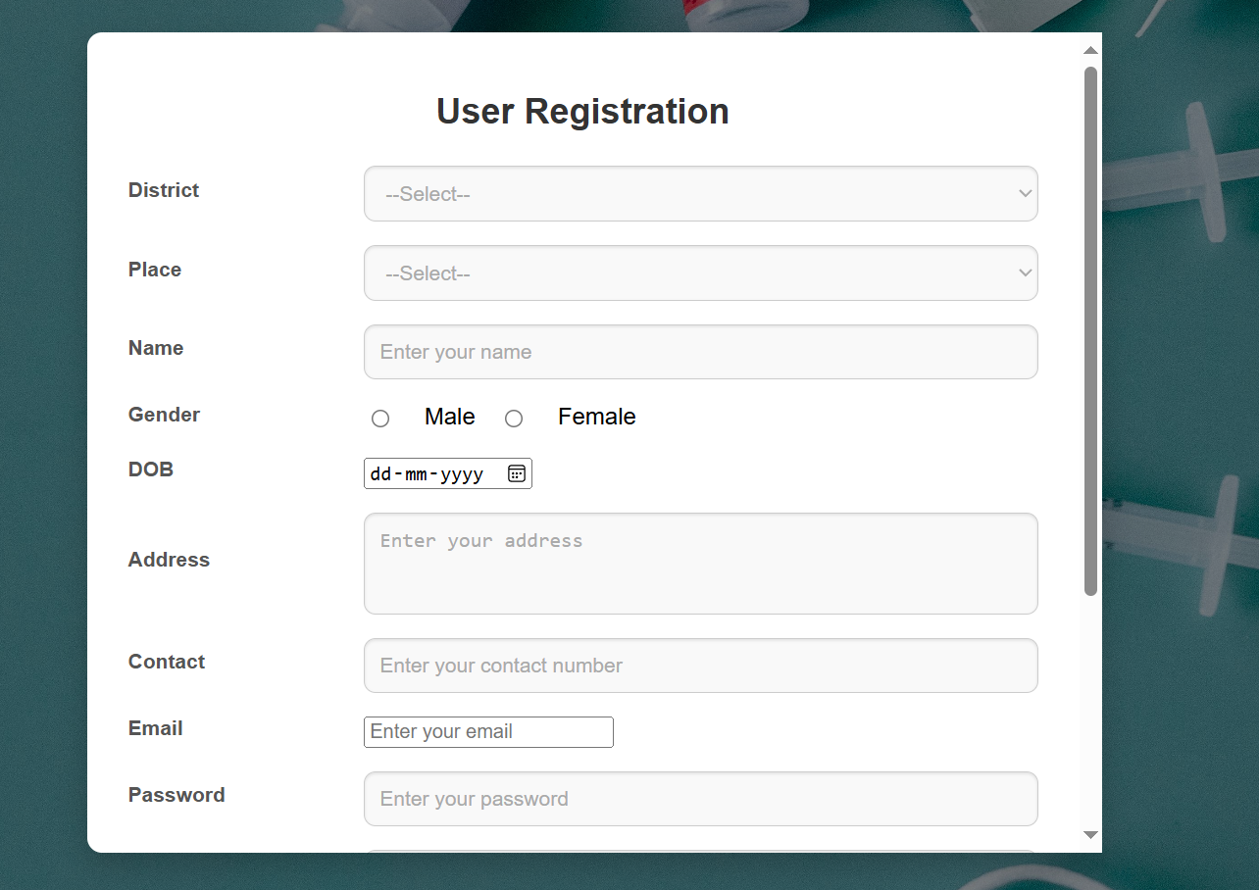
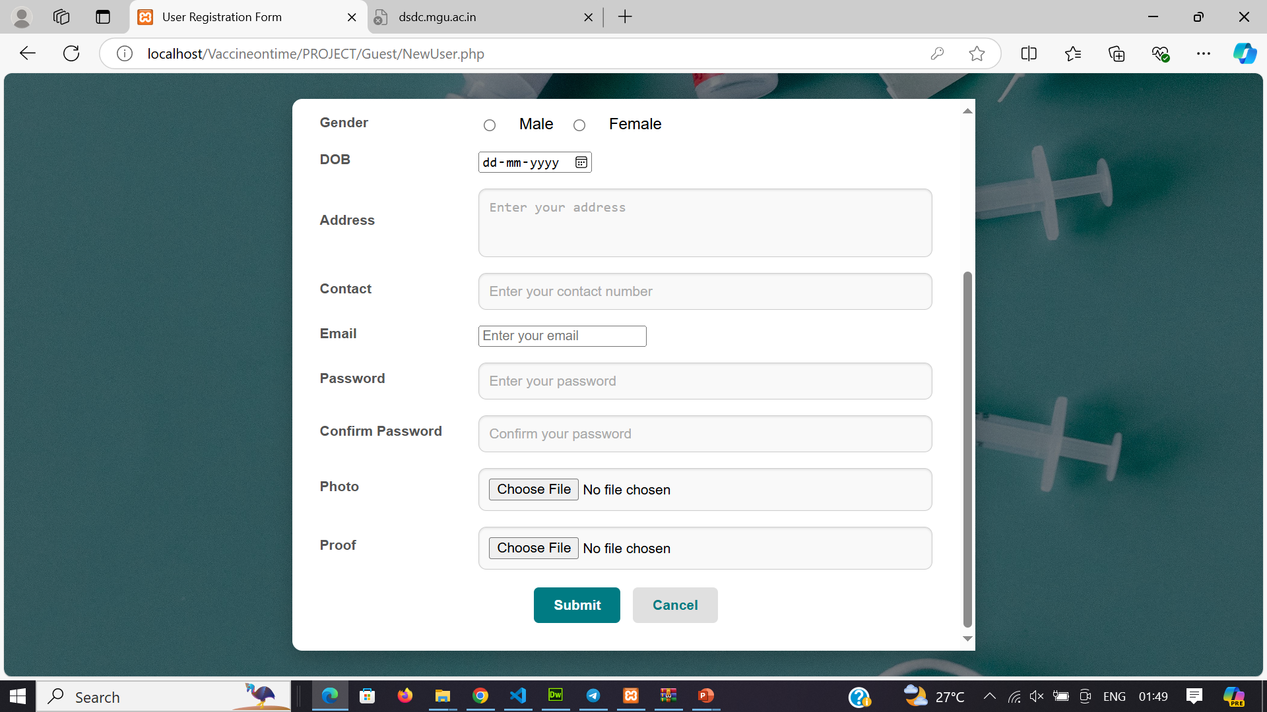
USER REGISTRATION

Slide 15
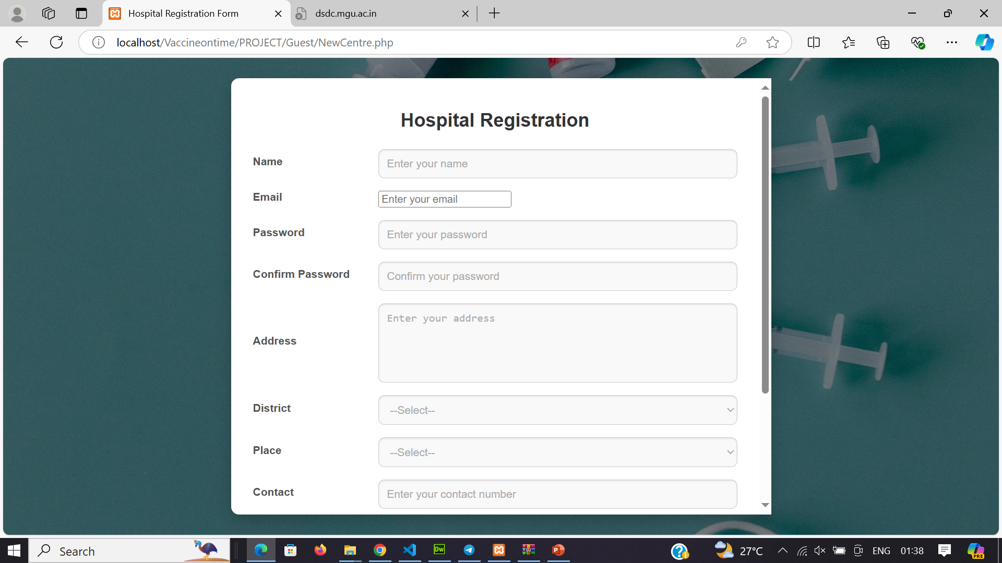
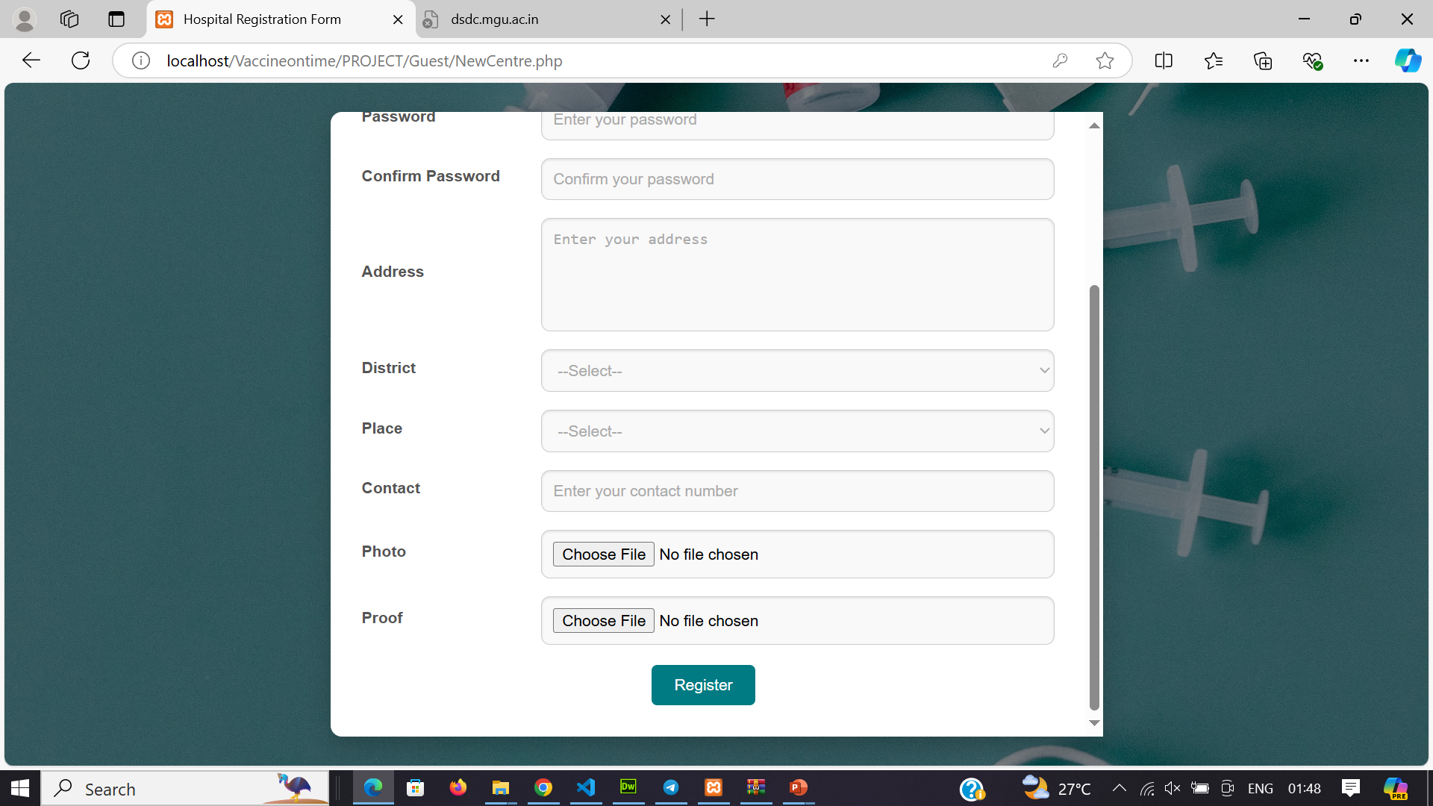
HOSPITAL REGISTRATION

Slide 16
THANK YOU…

